Slide 1

LHL Data Science Final Project - Demo Day August 18th 2022
Ripudaman Singh Bevli

Slide 2


About Me
Personal Profile:
Chemical Engineer (Class of 2022) - The University of British Columbia
Love Problem Solving and Tackling Real World Issues
Passionate for Data - Driven Solutions
Hobbies:
Hiking, Reading, Basketball

Slide 3
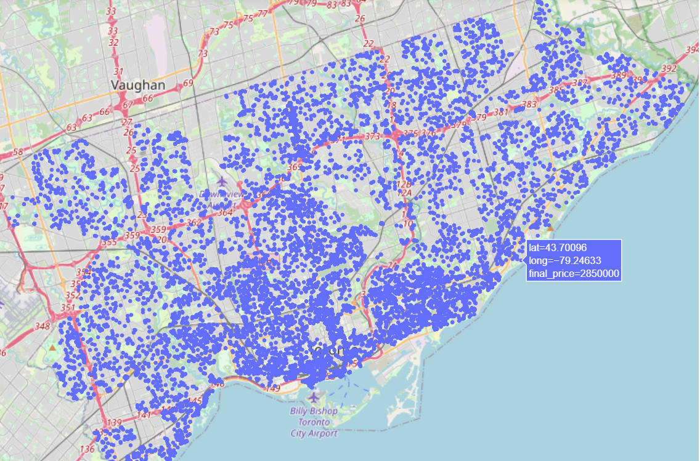
Overview
Project Description:
Build an efficient and accurate Toronto Home Price Predictor using Regression models (Supervised Learning)
Build a Home Recommender System that takes an interested buyer’s preferred house characteristics as inputs and recommends the 5 closest matching homes to the Buyer.
Toronto, Ontario

Slide 4
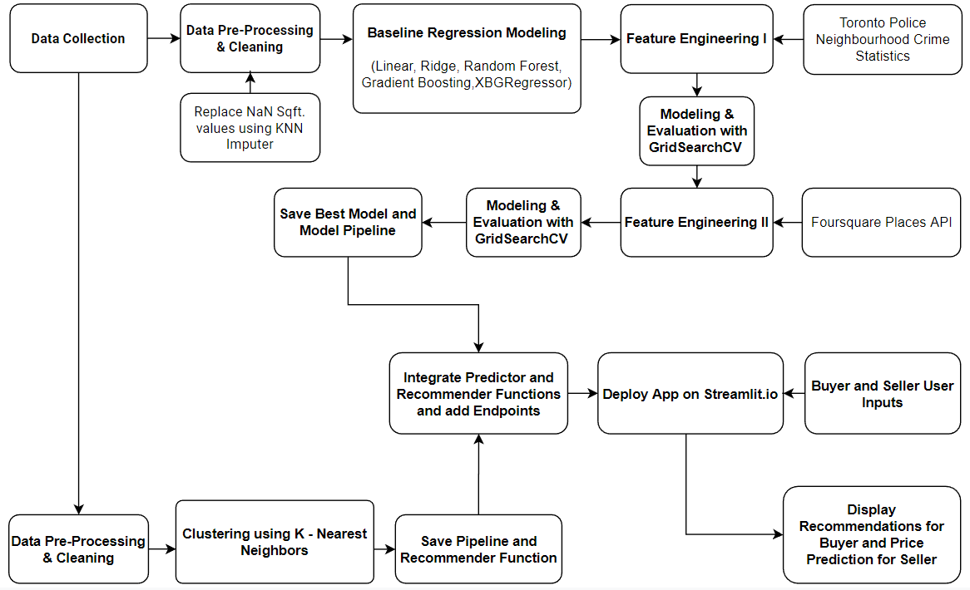
Methodology

Slide 5
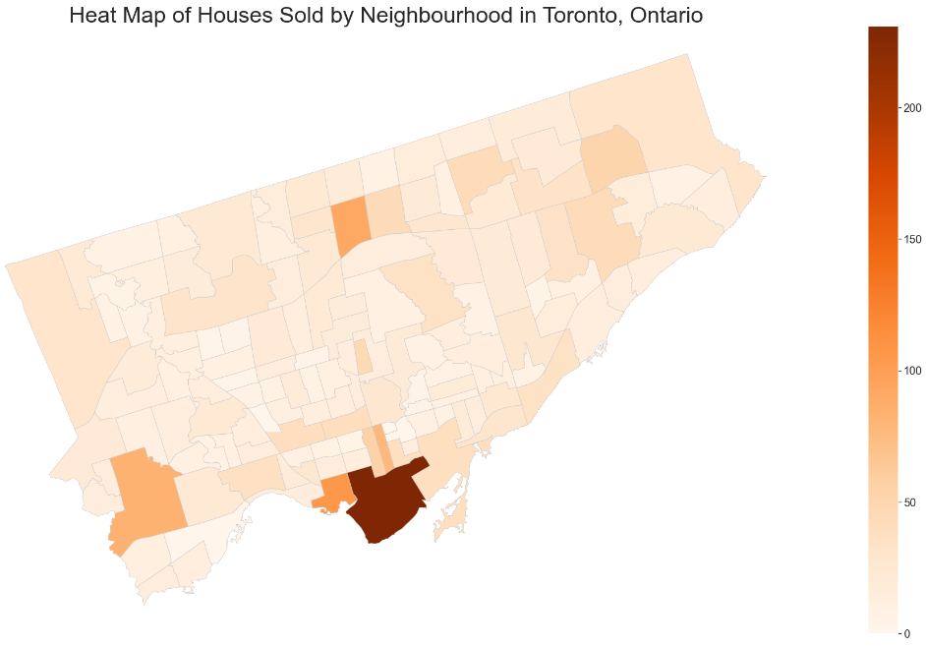
Data Exploration
Toronto Neighbourhoods by Avg Price (CAD) :
1) Forest Hill South - 2.73 million
2) Rosedale-Moore Park - 2.33 million
3) Bridle Path-Sunnybrook-York Mills - 2.32 million
Toronto Neighbourhoods by Number of Listings :
1) Waterfront Communities - The Island - 1148 (Avg Price - 732,079 CAD)
2) Niagara - 533 (Avg Price - 693,141 CAD)
3) Mimico - 523 (Avg Price - 710,459 CAD)
Waterfront Communities
Forest Hill South

Slide 6
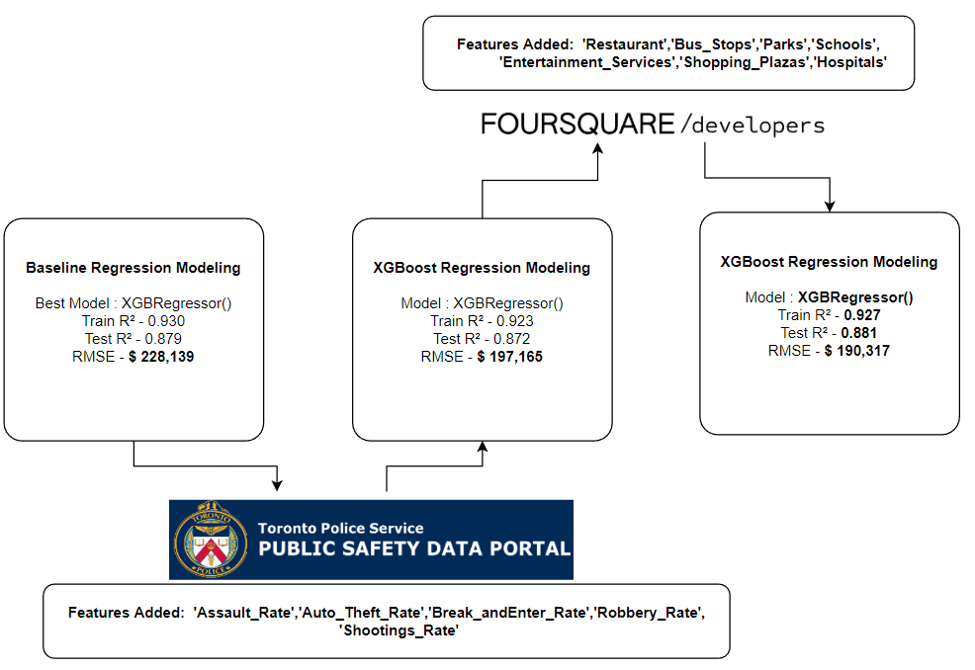
Feature Engineering & Modeling

Slide 7
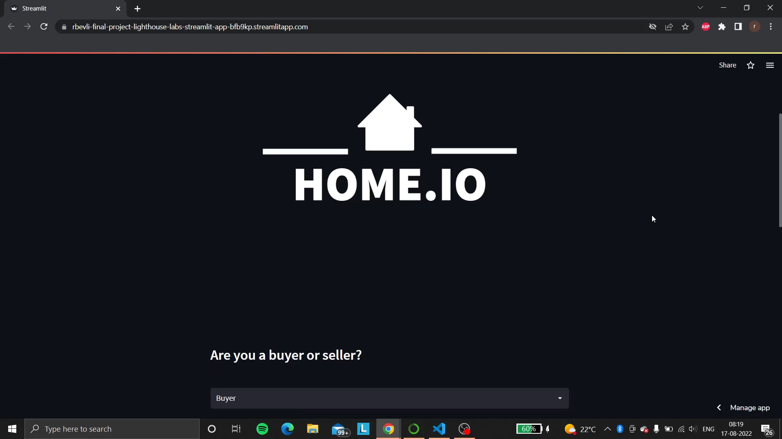

Slide 8
Results & Next Steps
Conclusion:
Regression Model improved in performance after adding Crime Statistics. The model further improved after adding neighbourhood features using the Foursquare Places API. RMSE value decreased as new features were engineered.
Clustering Model successfully recommended most similar homes.
Next Steps:
Access to dates of listings so as to engineer socio-economic features such as mortgage rates, home inflation rates.
Employ the use of Natural Language Processing do analyse the description of homes and extract useful features that are embedded in the textual description. Also employ Natural Language Processing for the recommender system so Buyers can input their preferences through a search engine.
Remodel Regression and Clustering using Neural Networks so as to improve model performance.

Slide 9
Thank You!

